Slide 1

LOCATION DECISION OF A MUSEUM SERVICE FIRM

Slide 2
INTRODUCTION
Wave Inc is a Museum Service Firm in Seattle, Washington
The firm’s management have decided to expand its business to 15 more cities in the US
Their most preferred cities should have a significant number of top-rated museums
Their most preferred cities should also have a relatively higher population (at least 100,000 people)
Importantly, the museums in the city should be rated by many people, have received a large number of likes and tips online.
Higher rating, higher rating counts, higher numbers of likes and tips for a Museum in the firm’s view, leads to higher investment in museum service firms by the Museum administrators

Slide 3
INTRODUCTION
IN THIS PROJECT,
We analyze the location decision of Wave Inc
We compare different cities in the US based on the average rating of museums in the city, average number of people that have rated the museums (ratingCount), average number of likes received by each museum (likesCount), average number of tips (tipCount), and the average number of top rated museums in the city
Cities that rank high on all of these variables would be selected as the ideal location for the museum service firm to locate

Slide 4
DATA
We use data from different sources:
We scrapped the list of cities with at least 100,000 inhabitants from Wikipedia
We did a Foursquare.com API search to find the top rated museums in each city
We did a Foursquare.com API venue search to find the rating, number of ratings(ratingCount), number of likes (likesCount), and number of tips(tipsCount) of each museum.
For each city we average out the variables so that the final dataset contains the average ratings, ratingsCount, likesCount, and tipsCount for each city, as well as the number of museums in each city (N)

Slide 5
DATA (summary Statistics)
 | rating | ratingCount | tipCount | likesCount | N
count | 303 | 303 | 303 | 303 | 303
mean | 7.75 | 98.65 | 16.79 | 77.77 | 12.56
std | 0.44 | 161.92 | 20.04 | 137.19 | 10.92
min | 6.42 | 9.33 | 1 | 5 | 1
25% | 7.48 | 31.65 | 7 | 21.33 | 4
50% | 7.79 | 60.72 | 11.71 | 45.2 | 9
75% | 8.01 | 112.85 | 21.91 | 88.75 | 19
max | 8.98 | 2265.83 | 265.6 | 1932.6 | 59

Slide 6
Methodology
We use the K-means clustering Algorithm
The algorithm partitions all the cities into k clusters in a way that minimizes the with-in cluster variation
We partition the cities in the dataset into 5 clusters based on the variables rating, ratingCount, likescount, tipsCount, and N (number of museums)
We visualize the clusters on a map

Slide 7
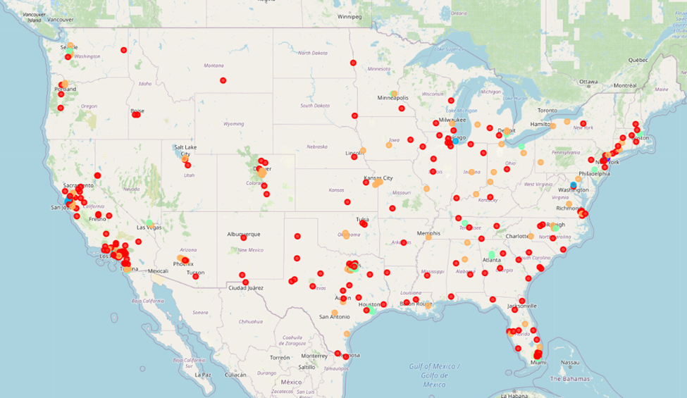
Results (visualization)
Cluster 1
Cluster 2
Cluster 3
Cluster 4
Cluster 0

Slide 8
Results
The fives clusters are entirely different and can be ranked
Cluster 1 has significantly high values for all the variables, followed by cluster 2, and then cluster 3
The table below show the average of each within each cluster
Cluster Labels | rating | ratingCount | tipCount | likesCount | N
1 | 8.976667 | 2265.83333 | 265.6 | 1932.6 | 30
2 | 8.685402 | 588.01757 | 77.05041 | 491.48145 | 32.57143
3 | 8.165059 | 235.738679 | 35.52228 | 190.43356 | 23.07143
4 | 7.971613 | 115.922321 | 21.213 | 90.657796 | 18.16667
0 | 7.549628 | 39.191582 | 8.224405 | 28.659822 | 7.52459

Slide 9
Results
New York City is the only city in cluster 1
Cluster 2 contains seven cities: Chicago, Daly City, Los Angeles, Newark, Richmond, San Francisco, and Washington DC.
To obtain the 15 cities the firm should locate in, We select 7 additional cities from the 28 cities in cluster 3.
The selection is based on the rank of the cities in the cluster 3 based on a new variable, size, that is the product of all the variables in the dataset
The selected cities include Glendale (California), Seattle, Boston, Bellevue, Philadelphia, Atlanta, Sandy Springs, Pasadena.

Slide 10
Discussion
Seattle, where the firm has been very successful is not even among the top two clusters
Seattle is in cluster 3
Therefore we expect the firm to be much more successful if they locate in the cities in clusters 1 and 2
Naively selecting cities to locate based only on the number of museums in the city would have led to a different selection with poorly rated and smaller museums that are likely to invest less in the services of a museum service firm

Slide 11
Conclusion
The project compared and clustered different cities in the US based on factors that are more likely to lead to profits for museum service firms that locates in the city.
The analysis yield New York, Chicago, Los Angeles, San Francisco, Washington DC, among others as the top locations for a museum service firm
For simplicity, we assumed that the location decision does not depend on the presence of other museum service firms in the city
The analysis of firm competition or the presence of other museum service firms would have on the location decision is left for future work

Slide 12
Thank you!

